Slide 1
HONEYCON NETWORK
Dynamic Honeypot Scaling Using Docker & OpenFlow
Thomas Green | Lancaster University

Slide 2

INTRODUCTION
What is a Honeypot?
Network decoys designed to attract and trap attackers
The Problem with Static Defences
Traditional systems are easily fingerprinted or bypassed by attackers. As networks grow, they struggle to handle higher traffic volumes and more complex attacks.

Slide 3
AIMS OF THE SYSTEM
To deploy scalable, dynamic honeypot containers that automatically scale to traffic volume
Docker Containers
OpenFlow / SDN
Lightweight honeypots deployed on automatically based on the demand.
Manipulates flow tables on the switch in real time. Pushes rules to redirect malicious traffic to honeypots.
Dynamic Scaling
Attack Logging
Scales up automatically during high-volume attacks. Scales back down during low volume periods, preventing resource waste.
Every interaction inside the honeypot is logged, providing valuable data for potential vulnerabilities.

Slide 4

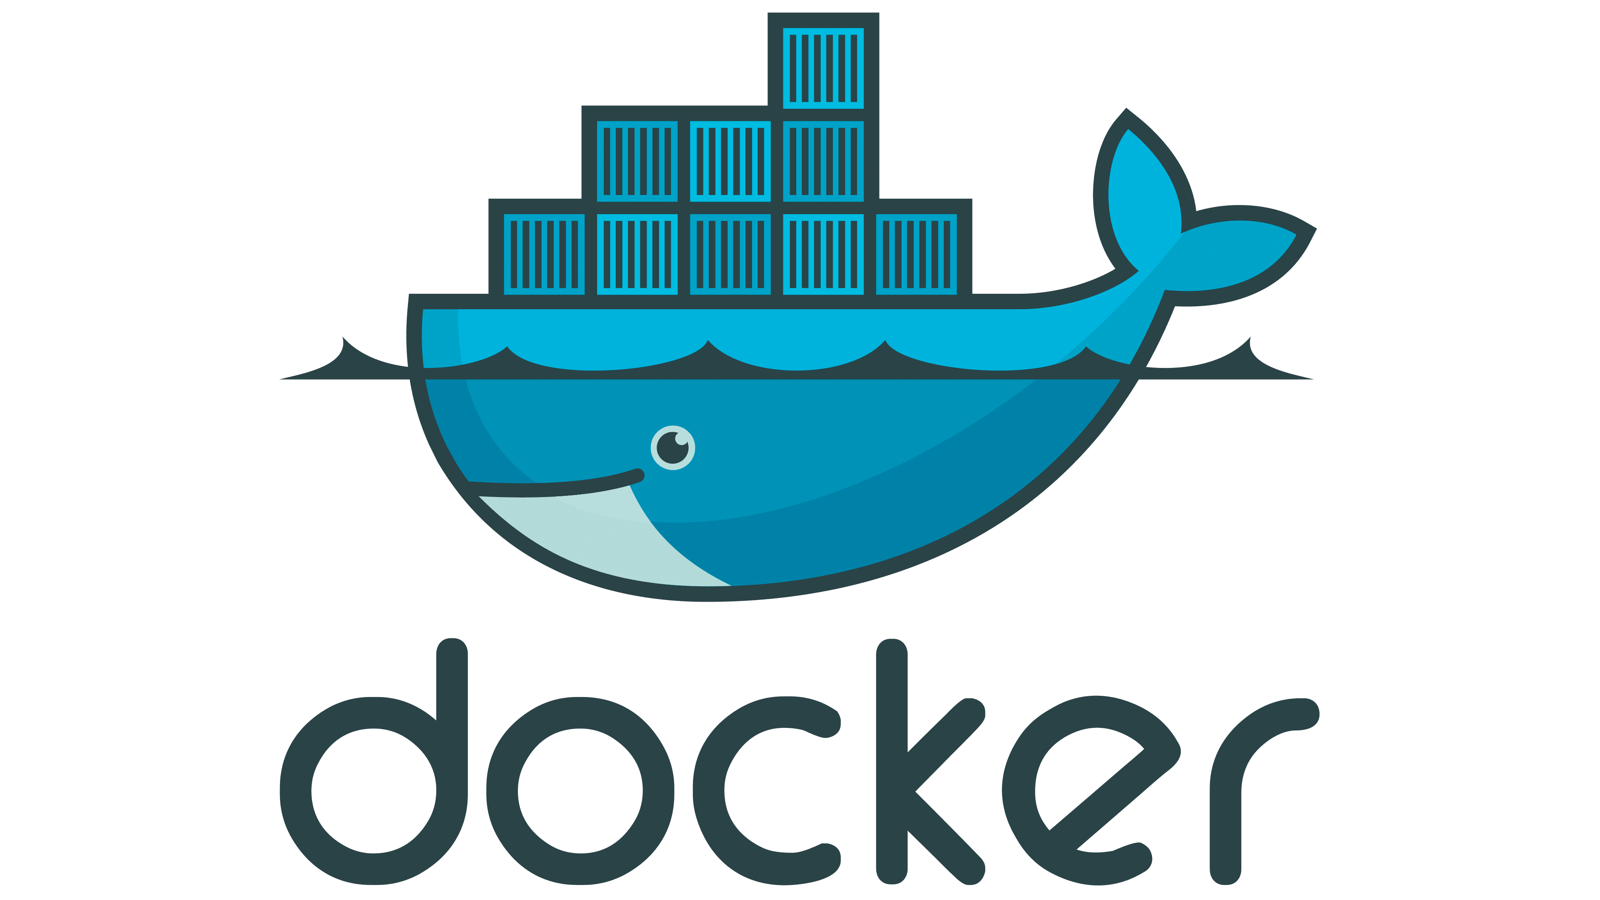
CORE OBJECTIVES
1
Develop & deploy a honeypot network
Use Docker to create lightweight honeypot containers that can be spun up or down.
2
Integrate OpenFlow for traffic management
Use the OSKen SDN controller that implements OpenFlow. OSKen is a fork of Ryu.
3
Automate scaling of honeypots
Monitor traffic volume and automatically deploy honeypots depending on demand.
4
Evaluate the system’s effectiveness
Log attacker interactions to see what they’re trying to do.

Slide 5
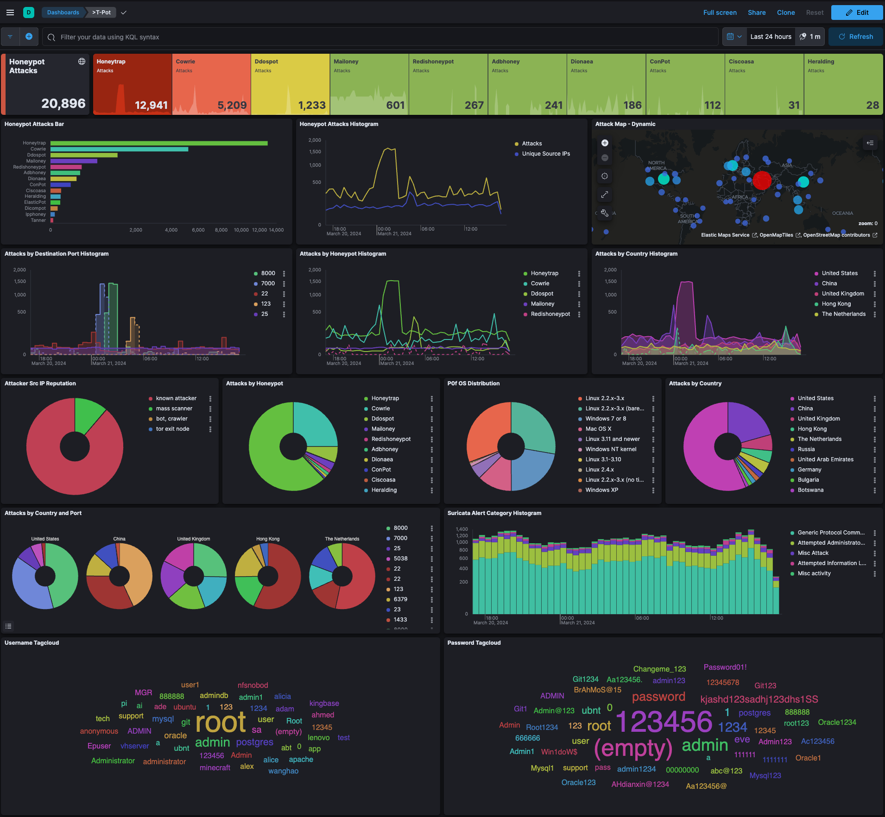


MOTIVATION AND BACKGROUND
▸ Traditional Security Measures
Firewalls and most IDS are rule-based — they only catch known signatures. Zero-day attacks slip through.
▸ Role of Honeypots
Honeypots don't block attacks, instead they observe them.
▸ Related Work: T-POT & Honeyd
T-POT (Deutsche Telekom) supports 20+ honeypots. Honeyd simulates networks. Both are static and can run a predefined number of honeypots and can't scale up during high-volume attacks or down during quiet periods.
▸ How HoneyCon is Different
Dynamic yet lightweight

Slide 6
SYSTEM DESIGN & ARCHITECTURE
HoneyCon uses a 3 tier architecture – each layer has a distinct job.
① DETECTION LAYER
Every packet passes through the OVS switch. The OSKen controller listens for PacketIn events. It checks the TCP header for the SYN bit (0x02). On detection, it logs the source IP and increments a counter file (syn_count.txt).
OSKen SDN Controller + Open vSwitch
▼
② ORCHESTRATION LAYER
Checks syn_count.txt every second. When count ≥ traffic threshold, runs docker run to start a new Cowrie container, assigns port 2222+N. When threshold hits 0 for 3 seconds -removes the previous container.
honeypot-scaling.py
▼
③ DECEPTION LAYER
Each Cowrie container presents a fake SSH server. Login attempts and all commands are silently logged.
Cowrie Docker Containers

Slide 7
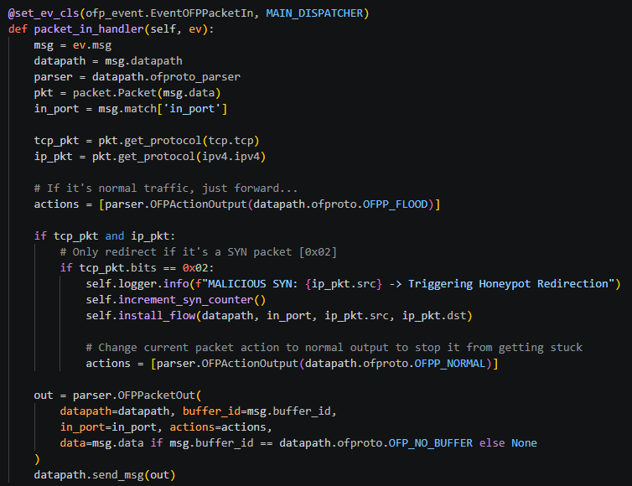
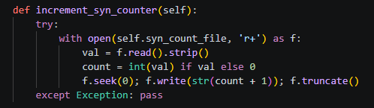
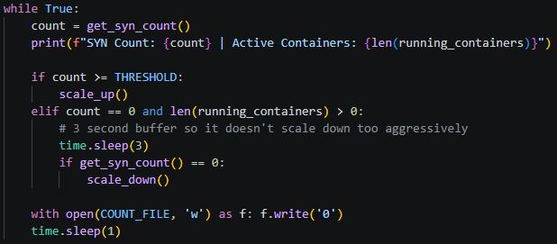
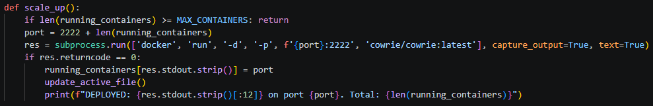
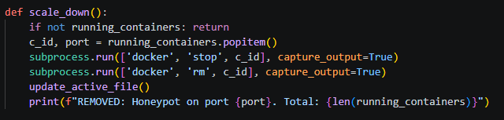

SYSTEM DESIGN & ARCHITECTURE
Code snippets
① DETECTION LAYER
▼
② ORCHESTRATION LAYER
▼
③ DECEPTION LAYER

Slide 8
NETWORK TOPOLOGY & TRAFFIC REDIRECTION
1
Mininet simulates the network: 5 hosts connected to a single Open vSwitch (s1).
h1
2
Attacker (h2) launches a SYN flood: hping3 -S --flood -V -p 22 10.0.0.1
h5
h2
OSKen controller detects SYN bit (0x02) via PacketIn → increments syn_count.txt.
3
s1
4
Threshold breached → scaling script deploys a new Cowrie container on port 2222+N.
h4
h3
Flow rule installed: attacker's source IP ‘should be’ silently redirected to 172.17.0.x (the honeypot), with idle_timeout=20 s.
5
6
Attacker interacts with the honeypot - unaware it is a decoy. All actions of the attacker are logged.
Mininet Star Topology
5 hosts · 1 OVS switch

Slide 9
IMPLEMENTATION
controller.py
honeypot-scaling.py
topology.py
Extends OSKenApp — Ryu fork compatible with Python 3.12
Registers EventOFPPacketIn on MAIN_DISPATCHER
Checks tcp_pkt.bits == 0x02 (SYN flag only)
Calls increment_syn_counter() → writes to syn_count.txt
install_flow() picks a random honeypot IP (172.17.0.x)
OFPFlowMod with priority=100 and idle_timeout=20 s
Normal traffic is flooded
Reads syn_count.txt every 1 second
Threshold: 20 SYN packets → deploy a new container, if below threshold progressively remove containers after 3s.
docker run -d -p {port}:2222 cowrie/cowrie:latest
Port assigned: 2222 + len(running_containers)
Tracks containers in a dict {container_id: port}
Hard cap of 50 containers – can be adjusted.
Mininet Topo subclass — star layout
1 central switch (s1) + 5 hosts (h1–h5)
Run command:
sudo mn --custom topology.py --topo topology
--controller remote --link tc

Slide 10
TESTING & EVALUATION
Functional Tests
Cowrie SSH honeypot
PASS
Fake login prompt, logs all attempts
Command isolation
PASS
ls, cd, sudo rm -rf /* — all captured
Mininet pingall
PASS
0% packet drop — 20/20 received
SYN detection
PASS
controller.py intercepts & logs src IP
Auto scale-up
PASS
New container deployed on threshold breach
Auto scale-down
PASS
Container removed after 3s idle
Network redirection
FAIL
Not properly redirecting traffic.

Slide 11
IMPLEMENTATION CHALLENGES
1. Framework Deprecation
Problem: The Ryu SDN framework fails to install on Python 3.12 — the 'distutils' module was removed from the standard library.
Solution: Migrated to OSKen: an actively maintained fork of Ryu, fully compatible with Python 3.12+.
2. Network Redirection
Problem: Redirecting the traffic to the honeypot containers that were created.
Solution: Prioritised a proof-of-concept: scaling and flow rule installation. Glutton (a protocol-agnostic honeypot) is identified as the solution path for future implementations.
3. Cross-Layer Timing Gap
Problem: Using Layer 4 telemetry (SYN counts) to trigger a Layer 7 (Application Layer) response creates a window where the attacker might reach the real SSH port before a honeypot is ready.
Solution: Threshold set low (20 SYN packets, 1s polling loop) to minimise spin-up latency. The 3s scale-down buffer prevents premature removal of honeypots when traffic volume decreases.

Slide 12
CRITICAL EVALUATION
Review of Project Aims
Implement a system to scale honeypot containers dynamically.
Detection and scaling were achieved - redirection was attempted.
Lessons Learned
Always check framework compatibility. In hindsight I should have implemented a different honeypot to cowrie, something like Glutton. As cowrie is purely for SSH connections.
Changes from the Proposal
Initially planned to have multiple honeypot types.
Final Remarks
This is a proof of concept for being able to dynamically scale honeypots. A foundation has been created for future work.

Slide 13
CONCLUSION & FUTURE WORK
What Was Achieved
Future Work
SYN flood detection via OSKen controller
Dynamic scale-up/down of Cowrie containers
OpenFlow flow rules installed per attacker IP
Cowrie logs all brute-force & command activity
Star topology network emulated in Mininet
Proof of concept.
Full network redirection using Glutton honeypot (handles raw network streams) instead of Cowrie.
Machine Learning-based anomaly detection — move beyond fixed SYN threshold
Expand honeypot types: HTTP, DNS, ICS protocols – to capture wider range of attacks.
Web dashboard: real-time container map and attack geo-maps – ability to manage honeypots online.

